Slide 1
Object-Oriented Design

Slide 2
Data Driven Design
Find Objects
nouns in problem description
Find Actions/Operations
verbs, verb phrases
Associate actions with objects -- Responsibilities

Slide 3
Example: Marine Biology Simulation
Marine Biologists would like to simulate the movement of fish in a section of the San Francisco Bay. The fish remain in a relatively narrow range of depths, so it will be enough to simulate their movement in a horizontal plane. A rectangular grid of positions can be used to represent the region where the fish move. At each step of the simulation, fish should move horizontally or vertically into any empty neighboring position, randomly selected. If there is no empty neighboring position for a particular fish, it remains in the same place. The fish move in sequence. The biologists assume that, based on the currents in the region under study, the order of fish movement is based on their positions, starting in the upper left (northwest) corner of the region and moving across the rows of the grid, then down row-by-row. After each step of the simulation, the positions of the fish should be displayed. The initial population of fish and their positions, as well as the number of rows and columns in the grid, is read from a file specified by the user. The simulation will run for a number of steps specified by the user.

Slide 4
Nouns
Marine Biologists would like to simulate the movement of fish in a section of the San Francisco Bay. The fish remain in a relatively narrow range of depths, so it will be enough to simulate their movement in a horizontal plane. A rectangular grid of positions can be used to represent the region where the fish move. At each step of the simulation, fish should move horizontally or vertically into any empty neighboring position, randomly selected. If there is no empty neighboring position for a particular fish, it remains in the same place. The fish move in sequence. The biologists assume that, based on the currents in the region under study, the order of fish movement is based on their positions, starting in the upper left (northwest) corner of the region and moving across the rows of the grid, then down row-by-row. After each step of the simulation, the positions of the fish should be displayed. The initial population of fish and their positions, as well as the number of rows and columns in the grid, is read from a file specified by the user. The simulation will run for a number of steps specified by the user.

Slide 5
Nouns
Marine Biologists
movement 2
fish 8
section
San Francisco Bay
range
depths
horizontal plane
rectangular grid
positions 4
region 3
simulation 3
empty neighboring position 2
place
sequence
biologists
currents
order
fish movement
corner
rows 2
grid 2
step 3
population
number 2
columns
file
user 2

Slide 6
Verbs
Marine Biologists would like to simulate the movement of fish in a section of the San Francisco Bay. The fish remain in a relatively narrow range of depths, so it will be enough to simulate their movement in a horizontal plane. A rectangular grid of positions can be used to represent the region where the fish move. At each step of the simulation, fish should move horizontally or vertically into any empty neighboring position, randomly selected. If there is no empty neighboring position for a particular fish, it remains in the same place. The fish move in sequence. The biologists assume that, based on the currents in the region under study, the order of fish movement is based on their positions, starting in the upper left (northwest) corner of the region and moving across the rows of the grid, then down row-by-row. After each step of the simulation, the positions of the fish should be displayed. The initial population of fish and their positions, as well as the number of rows and columns in the grid, is read from a file specified by the user. The simulation will run for a number of steps specified by the user.

Slide 7
Verbs
simulate
remain 2
simulate
represent
move 3
randomly selected
assume
starting
moving across
displayed
read
specified
run

Slide 8
What are the objects?
What actions/operations go with which objects?
How do the objects interact?

Slide 9
CRC cards
Class
what an object is
Responsibility
which actions are associated with the object?
Collaborations
which other classes (objects) does this class interact with?

Slide 10
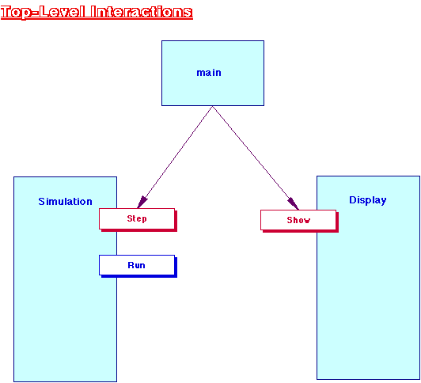

Slide 11
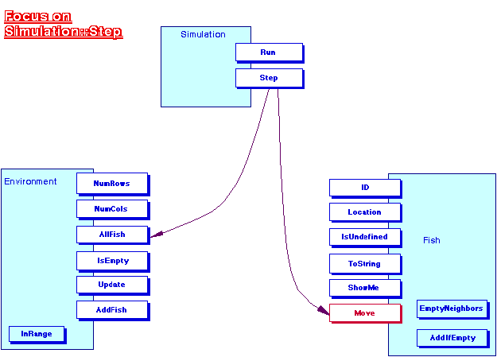

Slide 12
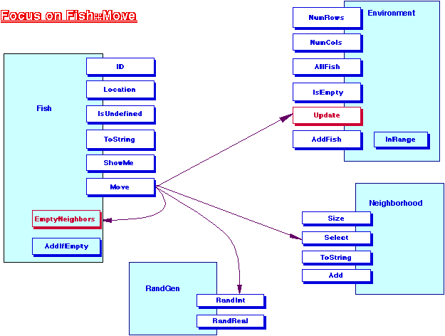

Slide 13
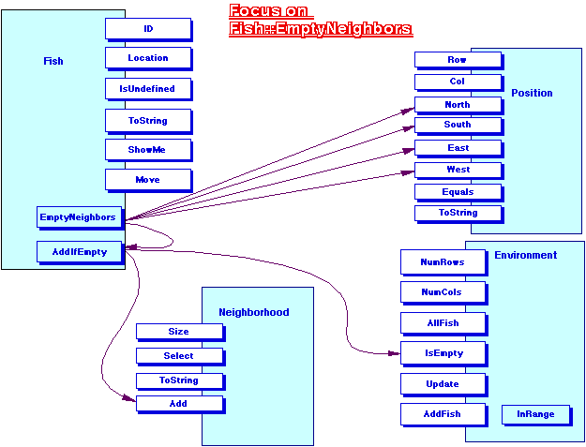

Slide 14
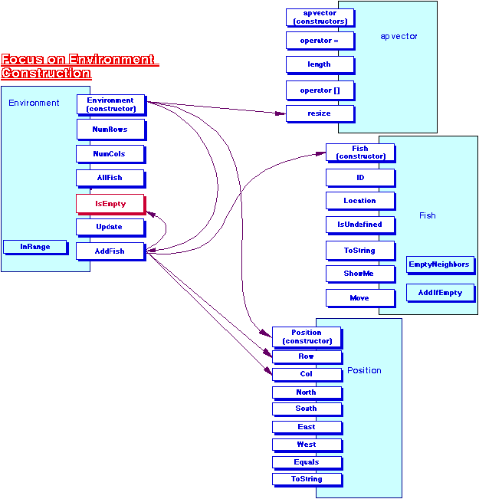

Slide 15
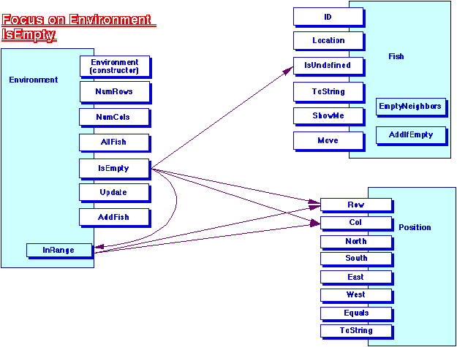

Slide 16
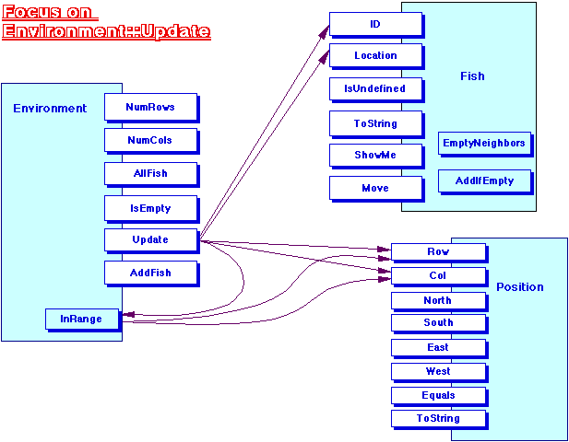

Slide 17
